Slide 1
Assessment of On Job Training-2

Slide 2
Role of intern in organization
During OJT-1,I was assigned as a software intern and learnt about different frontend technologies.
Continued in the same role and learnt some more web technology tools and utilize them efficiently.

Slide 3
Technical knowledge during OJT-2
Bootstrap
JavaScript

Slide 4
Bootstrap
Bootstrap is an open-source front-end framework that was created by twitter in 2011.
It is designed to simplify the process of building responsive and mobile-first websites.
Bootstrap provides a set of pre-designed UI components, such as buttons, forms, and navigation bars, as well as a grid system for laying out content.

Slide 5
Key features of Bootstrap
Responsive design
Pre-built UI components
Customization
Cross-browser compatibility
Extensive documentation:

Slide 6
Bootstrap usage
Bootstrap is simple and effective because it uses predefined classes to apply formatting
Use class attribute within HTML tags to apply text-formatting.
For e.g. <p class=“h1”></p>
In this example even though it is a p-tag, It has all the properties of a h1 tag.

Slide 7
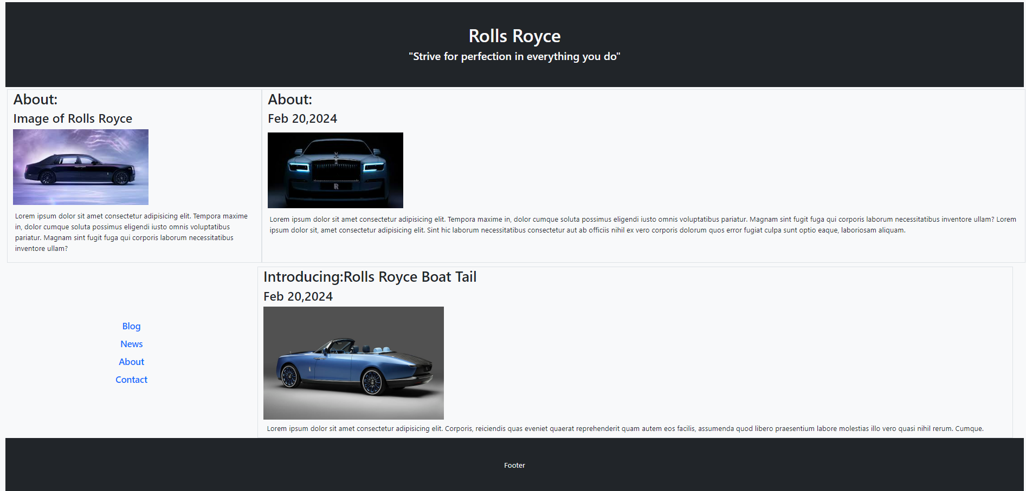
Bootstrap use case

Slide 8
JavaScript
JavaScript, created by Brendan Eich in 1995, was originally called Mocha and later Livescript.
It was developed for client-side web development, enabling dynamic and interactive web pages. initially used in Netscape navigator, it was quickly adopted by Microsoft for internet explorer.
JavaScript's popularity grew, contributing to the development of web applications, games, and form validation.

Slide 9
JavaScript engine
Source code
Compiler
Interpreter
Executable file

Slide 10
Datatypes
Conditional statements
Looping statements
Number
String
Boolean:
Object
Array
null
undefined
If statement
else statement
Else if statement
Nested if else
For loop
while loop
Do-while loop

Slide 11
JS Functions
async Functions
A function in JavaScript is a block of code design to perform a specific task. You can create a function using the “function” keyword followed by the function name, parenthesis (),and curly braces { } which contain the function body.
Call a function using function name followed by parenthesis to run the function.
Asynchronous functions are defined by “async” keyword and is used to run
Asynchronously meaning it can run independently without waiting for previous functions to finish it uses “fetch” and “await” keyword to pause execution until promise is resolved or rejected.

Slide 12
Arrays
objects
In JavaScript, an array is a data structure that can store multiple values.
Values are stored in indexes starting from 0
Arrays can contain elements of different data types, such as numbers, strings, objects, and other arrays
e.g
const fruits = ['apple', 'banana', 'cherry'];
Objects are key-value pairs where the keys are strings and the values can be of any data type.
JSON is separate file format to store JS objects with .json extension
e.g.
let obj={“name”:”person1”, “age”:19}

Slide 13
Events
Adds a event to html elements,only performs an action when event condition is met
onclick();-only when click
ondblclick();-only on double click
mouseover();only if mouse in over
mouseout();-only after mouse out
document.GetElementById-to get tag by id
document.GetElementByClassName get tag by class name
document.GetElementByTagName-to get tag by tag name

Slide 14
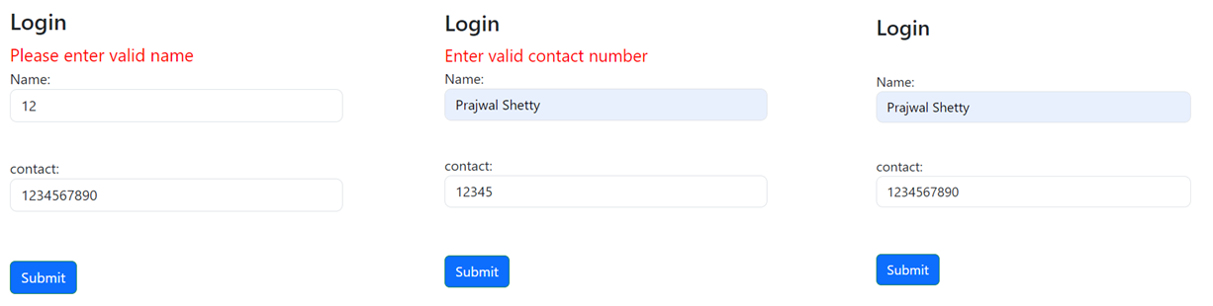
Js use case
Testcase-1
Testcase-2
Testcase-3

Slide 15
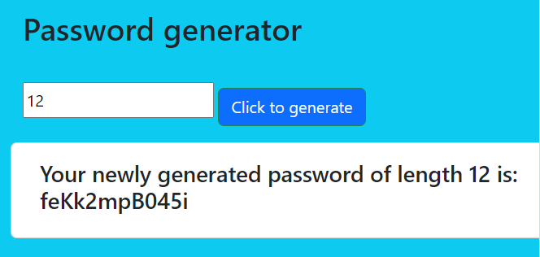
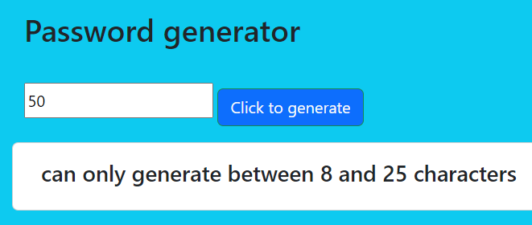
Js use case
Testcase-1
Testcase-2

Slide 16
Thank you!
Prajwal Shetty

